Slide 1
Operating Systems
Chapter 5 Mutual Exclusion(互斥) and Synchronization(同步)

Slide 2
Agenda
5.1 Principles of Concurrency
5.2 Mutual Exclusion: Hardware Support
5.3 Semaphores
5.4 Monitors
5.5 Message Passing
5.6 Readers/Writers Problem
5.7 Summary

Slide 3
Concurrency
Concurrency arises in three different contexts:
  Multiple applications(多应用程序)
    Multiprogramming
  Structured application(结构化应用程序)
    Some application can be designed as a set of concurrent processes
  Operating-system structure(操作系统结构)
    Operating system is a set of processes or threads
Notes:
Concurrency 并发性

Slide 4
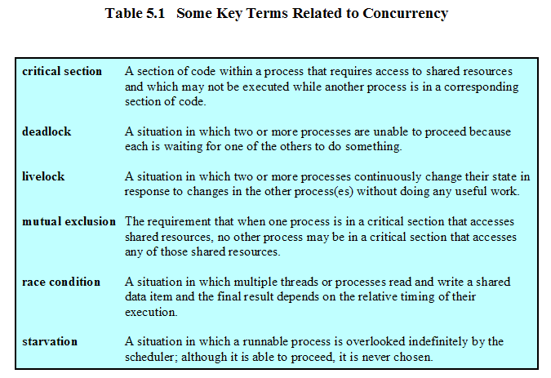
Concurrency
临界区
死锁
活锁
互斥
竞争条件
饥饿
Notes:
Deadlock:独木桥
Livelock:相向让路

Slide 5
5.1 Principles of Concurrency
5.1.1 A Simple Example
5.1.2 Race Condition
5.1.3 Operating System Concerns
5.1.4 Process Interaction
5.1.5 Requirements for Mutual Exclusion
Notes:
并发的原则

Slide 6
Difficulties of Concurrency
Sharing of global resources
Operating system managing the allocation of resources optimally
Difficult to locate programming errors
Notes:
It becomes very difficulty to locate programing error because the results are typically deterministic 不可再现 and reproducible 不可确定
操作系统很难对资源进行最优化分配。

Slide 7
A Simple Example
char chin, chout;
void echo()
{
chin = getchar();
chout = chin;
putchar(chout);
}

Slide 8
A Simple Example(Uniprocessor)
Process P1 Process P2
. .
chin = getchar(); .
chout = chin; . chin = getchar();
chout = chin;
putchar(chout);
putchar(chout); .
. .

Slide 9
A Simple Example(Multiprocessor)
Process P1 Process P2
. .
chin = getchar(); .
. chin = getchar();
chout = chin; chout = chin;
putchar(chout); .
. putchar(chout);
. .

Slide 10
5.1 Principles of Concurrency
5.1.1 A Simple Example
5.1.2 Race Condition
5.1.3 Operating System Concerns
5.1.4 Process Interaction
5.1.5 Requirements for Mutual Exclusion

Slide 11
Race Condition(竞争条件)
A race condition occurs when multiple processes or threads read and write data items so that the final result depends on the order of execution of instructions in the multiple processes or thread.
(竞争条件发生在当多个进程或者线程在读写数据时，其最终结果依赖于多个进程或者线程的指令执行顺序)
Notes:
Another example of online shopping

Slide 12
5.1 Principles of Concurrency
5.1.1 A Simple Example
5.1.2 Race Condition
5.1.3 Operating System Concerns
5.1.4 Process Interaction
5.1.5 Requirements for Mutual Exclusion

Slide 13
Operating System Concerns
Keep track of various processes(through PCB)
Allocate and deallocate resources
  Processor time
  Memory
  Files
  I/O devices
Protect data and resources
Output of process must be independent of the speed of execution of other concurrent processes
Notes:
The OS must be able to keep track of the various processes. This is done with the use of PCB and was described in chapter 4
一个进程的功能和输出结果必须与执行速度(相对于其他并发进程的执行速度)无关。这是本章的主题。

Slide 14
5.1 Principles of Concurrency
5.1.1 A Simple Example
5.1.2 Race Condition
5.1.3 Operating System Concerns
5.1.4 Process Interaction
5.1.5 Requirements for Mutual Exclusion

Slide 15
Process Interaction(进程交互)
Processes unaware of each other
Processes indirectly aware of each other
Process directly aware of each other
Notes:
Processes unaware of each other-These are independent processes that are not intended to work together-competition
Processes indirectly aware of each other-they share access to some object-cooperation

Slide 16
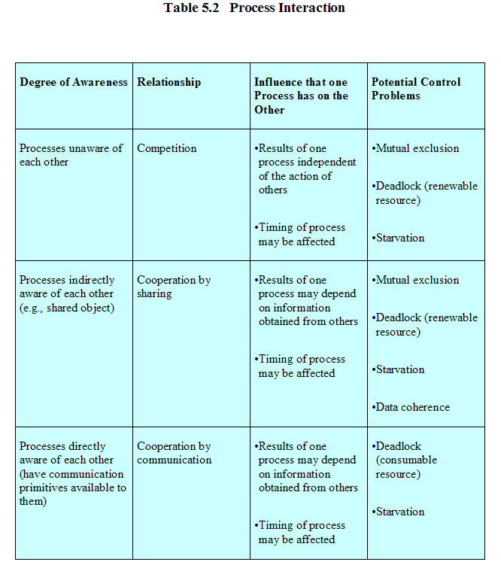

Slide 17
Competition Among Processes for Resources(进程间的资源争用)
Mutual Exclusion(互斥)
  Critical sections
    Only one program at a time is allowed in its critical section
    Example only one process at a time is allowed to send command to the printer
Deadlock(死锁)
Starvation(饥饿)

Slide 18
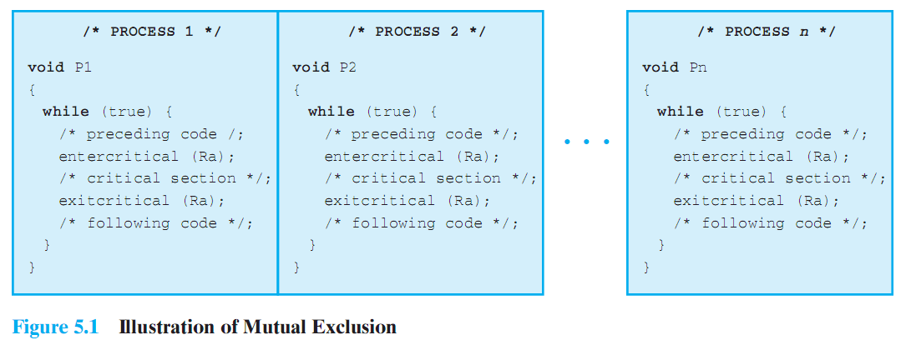
Illustration of Mutual Exclusion by critical section
.entercritical：进入临界区 .exitcritical：退出临界区

Slide 19
5.1 Principles of Concurrency
5.1.1 A Simple Example
5.1.2 Race Condition
5.1.3 Operating System Concerns
5.1.4 Process Interaction
5.1.5 Requirements for Mutual Exclusion

Slide 20
Requirements for Mutual Exclusion
Only one process at a time is allowed in the critical section for a resource (一次只允许一个进程进入临界区，忙则等待)
A process that halts in its noncritical section must do so without interfering with other processes (阻塞于临界区外的进程不能干涉其它进程)
No deadlock or starvation (不会发生饥饿和死锁，有限等待)
Notes:
互斥的要求

Slide 21
Requirements for Mutual Exclusion
A process must not be delayed access to a critical section when there is no other process using it (闲则让进)
No assumptions are made about relative process speeds or number of processes (对相关进程的执行速度和处理器数目没有要求)
A process remains inside its critical section for a finite time only (有限占用)
Notes:
互斥的实现方法有三个：
软件方法：并发执行的进程实现互斥，不需要操作系统或程序设计语言支持，会增加处理开销和缺陷
硬件方法：使用专门的机器指令，可以减少开销，单不通用
操作系统和程序设计语言提供支持，降低同步互斥的复杂性，降低互斥错误的可能性。

Slide 22
Agenda
5.1 Principles of Concurrency
5.2 Mutual Exclusion: Hardware Support
5.3 Semaphores
5.4 Monitors
5.5 Message Passing
5.6 Readers/Writers Problem
5.7 Summary

Slide 23
5.2 Mutual Exclusion: Hardware Support
5.2.1 Interrupt Disabling(中断禁止)
5.2.2 Special Machine Instructions(特殊机器指令)

Slide 24
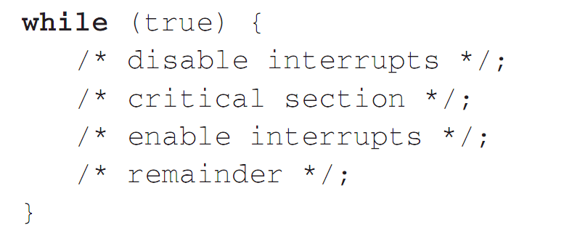
Hardware Support: Interrupt Disabling

Slide 25
Hardware Support: Interrupt Disabling
A process runs until it invokes an operating system service or until it is interrupted
Disabling interrupts guarantees mutual exclusion on uniprocessor system
Disadvantage:
  Processor is limited in its ability to interleave programs
  disabling interrupts on one processor will not guarantee mutual exclusion in multi-processors environment.
Notes:
交替interleave执行程序

Slide 26
5.2 Mutual Exclusion: Hardware Support
5.2.1 Interrupt Disabling
5.2.2 Special Machine Instructions

Slide 27
Hardware Support: Special Machine Instructions
Performed in a single instruction cycle
  Access to the memory location is blocked for any other instructions

Slide 28
Hardware Support: Special Machine Instructions
Compare and swap
int compare_and_swap(int *word,
int testval, int newval)
{
int oldval;
oldval = *word;
if ( oldval == testval) *word = newval;
return oldval;
}
Notes:
第6、7版教材为compare_and_swap(int *word, int testval, int newval)

Slide 29
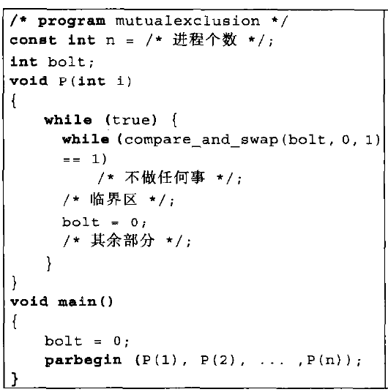
Hardware Support for Mutual Exclusion

Slide 30
Hardware Support: Special Machine Instructions
Exchange Instruction
void exchange(int register, int memory) {
int temp;
temp = memory;
memory = register;
register = temp;
}

Slide 31
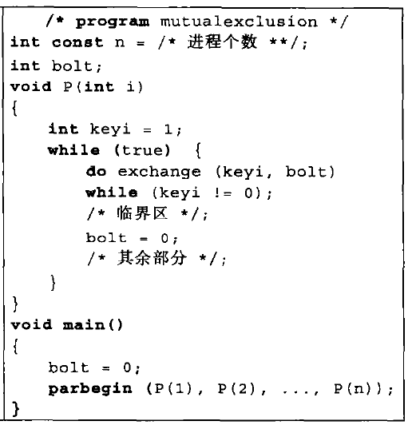
Hardware Support for Mutual Exclusion

Slide 32
Hardware Support: Special Machine Instructions
Advantages
  By sharing main memory，it is applicable to any number of processes
    single processor
    multiple processors
  It is simple and therefore easy to verify
  It can be used to support multiple critical sections

Slide 33
Hardware Support: Special Machine Instructions
Disadvantages
  Busy-waiting(忙等待) consumes processor time
  Starvation(饥饿) is possible when a process leaves a critical section and more than one process is waiting.
  Deadlock (死锁) is possible
    If a low priority process has the critical region and a higher priority process needs, the higher priority process will obtain the processor to wait for the critical region

Slide 34
Agenda
5.1 Principles of Concurrency
5.2 Mutual Exclusion: Hardware Support
5.3 Semaphores
5.4 Monitors
5.5 Message Passing
5.6 Readers/Writers Problem
5.7 Summary

Slide 35
5.3 Semaphores
5.3.1 Overview
5.3.2 Mutual Exclusion
5.3.3 The Producer/Consumer Problem
5.3.4 Implement of Semaphores

Slide 36
Semaphores(信号量)
Fundamental principle(基本原理): Two or more processes can cooperate by means of simple signals, such that a process can be forced to stop at a specified place until it has received a specific signal.(两个或者多个进程可以通过简单的信号进行合作，一个进程可以被迫在一个位置停止，直到它收到一个信号)
For signaling, special variables called semaphores are used(一种称为信号量的特殊变量用来传递信号)
If a process is waiting for a signal, it is suspended until that signal is sent (如果一个进程在等待一个信号，它会被挂起，直到它等待的信号被发出）

Slide 37
Semaphores
Semaphore is a variable that has an integer value(整数值)
  Initialize：May be initialized to a nonnegative number(非负数)
  semWait (P)：Wait operation decrements the semaphore value，If the value becomes negative, then the process executing the semWait is blocked.
  semSignal (V)：Signal operation increments semaphore value，If the resulting value is less than or equal to zero, then a process blocked by a semWait operation, if any, is unblocked.
Notes:
semSignal操作使信号量加1。如果值小于或者等于零，则被samWait操作阻塞的进程被解除阻塞。

Slide 38
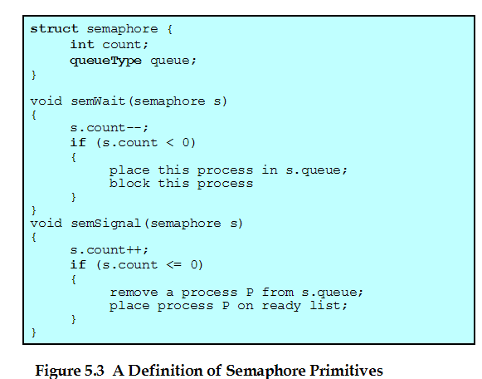
Semaphore Primitives(原语，原子操作)

Slide 39
Binary Semaphore(二元信号量)
Binary Semaphore is a variable that has an integer value
  May be initialized to 0 or 1.
  semWaitB：checks the semaphore value. If the value is zero, then the process executing the semWaitB is blocked. If the value is one, then the value is changed to zero and the process continues execution.
  semSignalB：checks to see if any processes are blocked on this semaphore. If so, then a process blocked by a semWaitB operation is unblocked. If no processes are blocked, then the value of the semaphore is set to one.

Slide 40
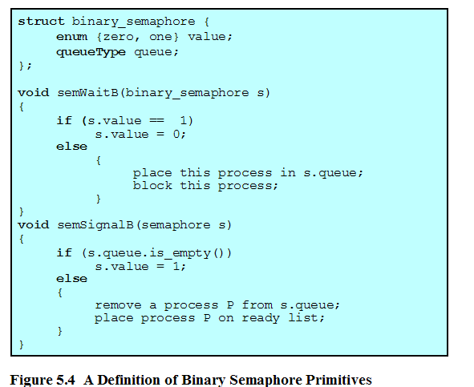
Binary Semaphore(二元信号量) Primitives(原语)

Slide 41
Semaphore terms (信号量术语)
Binary Semaphore (二元信号量)
Mutex (互斥信号量)
Counting Semaphore (计数信号量)
General Semaphore(一般信号量)
Weak Semaphore(弱信号量)
Strong Semaphore(强信号量)
Notes:
互斥信号量，就是申请释放再同一个进程，二元则可以分开在不同的进程；非二元信号量，称为一般信号量（计数信号量）；强信号，保证先来先解除阻塞；弱信号量不保证；

Slide 42
5.3 Semaphores
5.3.1 Overview
5.3.2 Mutual Exclusion
5.3.3 The Producer/Consumer Problem
5.3.4 Implement of Semaphores

Slide 43
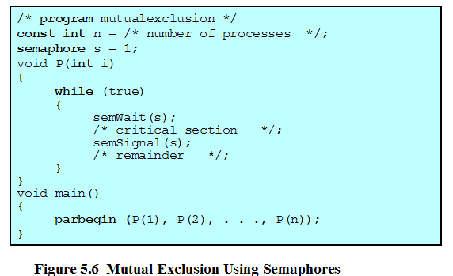
Mutual Exclusion Using Semaphores

Slide 44
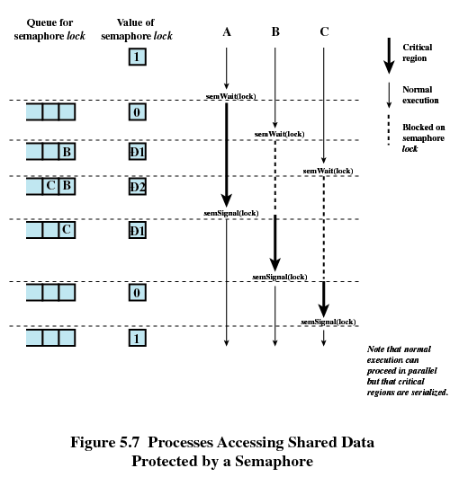
-1
-2
-1

Slide 45
More than one process in its critical section at a time(多个进程同时在临界区内)
Initialize the semaphore to the specified value
s.count >= 0: s.count is the number of processes that can execute semWait(s) without suspension
s.count < 0: The magnitude of s.count is the number of processes suspended in s.queue.

Slide 46
5.3 Semaphores
5.3.1 Overview
5.3.2 Mutual Exclusion
5.3.3 The Producer/Consumer Problem
5.3.4 Implement of Semaphores

Slide 47
Producer/Consumer Problem(生产者/消费者问题)
One or more producers are generating data and placing these in a buffer
A single consumer is taking items out of the buffer one at time
Only one producer or consumer may access the buffer at any one time

Slide 48
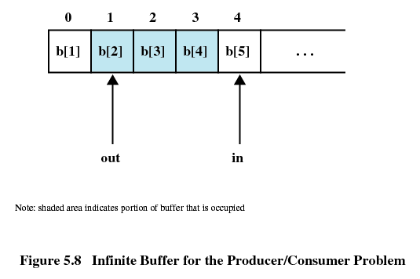
Producer/Consumer Problem with Infinite Buffer(无限缓冲区)

Slide 49
Producer with Infinite Buffer
producer:
while (true) {
/* produce item v */
b[in] = v;
in++;
}

Slide 50
Consumer with Infinite Buffer
consumer:
while (true) {
while (in <= out)
/*do nothing */;
w = b[out];
out++;
/* consume item w */
}

Slide 51
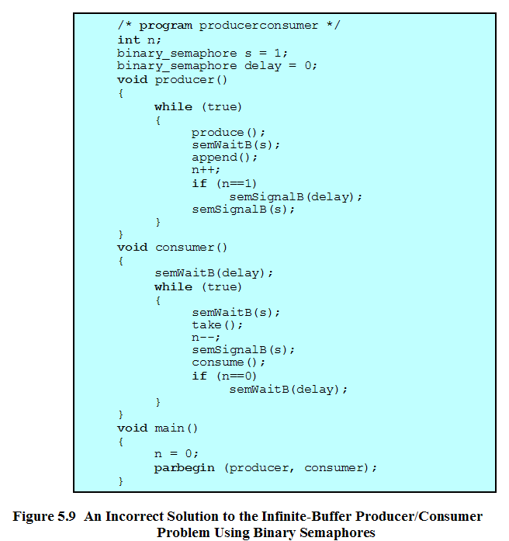
缓冲区中的项数
控制进入临界区
避免“超前”消费

Slide 52
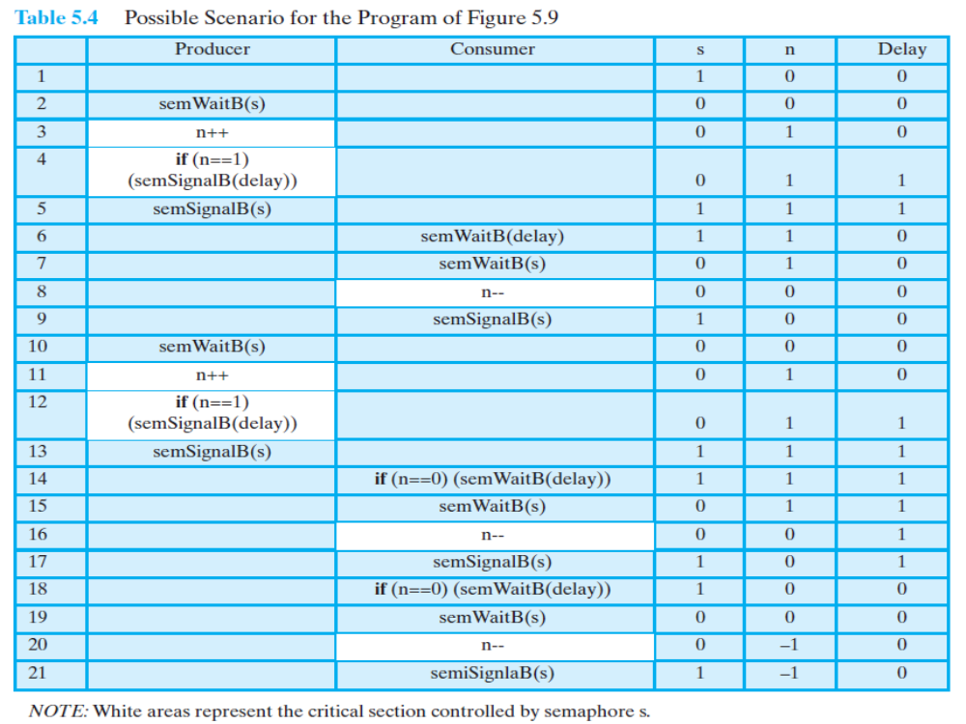

Slide 53
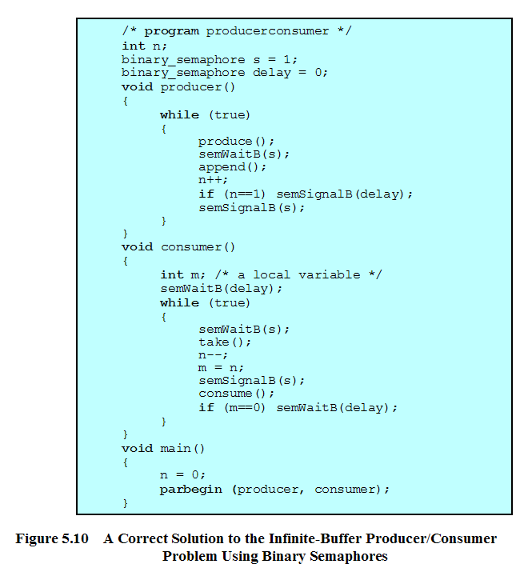

Slide 54
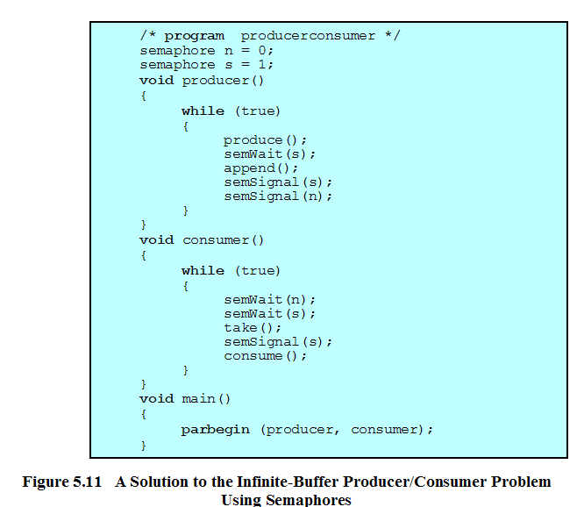
控制“超前消费”
控制进入临界区

Slide 55
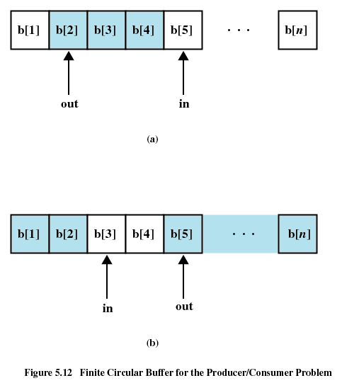
Producer/Consumer Problem with Finite Buffer(有限缓冲区)

Slide 56

Producer/Consumer Problem with Finite Buffer(有限缓冲区)
The buffer is treated as a circular storage, and pointer values must be expressed modulo the size of the buffer.
The following relationships hold:
Notes:
modulo 模数运算

Slide 57
Producer with Circular Buffer
producer:
while (true) {
/* produce item v */
while ((in + 1) % n == out) /* do nothing */;
b[in] = v;
in = (in + 1) % n
}

Slide 58
Consumer with Circular Buffer
consumer:
while (true) {
while (in == out)
/* do nothing */;
w = b[out];
out = (out + 1) % n;
/* consume item w */
}

Slide 59
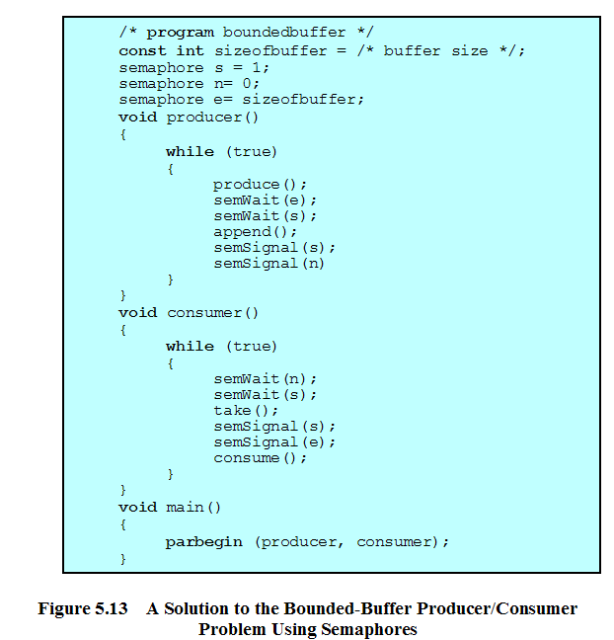
控制进入临界区
控制“超前”消费
控制生产“过剩”

Slide 60
5.3 Semaphores
5.3.1 Overview
5.3.2 Mutual Exclusion
5.3.3 The Producer/Consumer Problem
5.3.4 Implement of Semaphores

Slide 61
5.3.4 Implement of Semaphores
Implement in hardware or firmware(固件)
Implement in software, e.g. Dekker or Peterson
Implement by inhibit interrupts(中断禁止) for a single-processor system

Slide 62
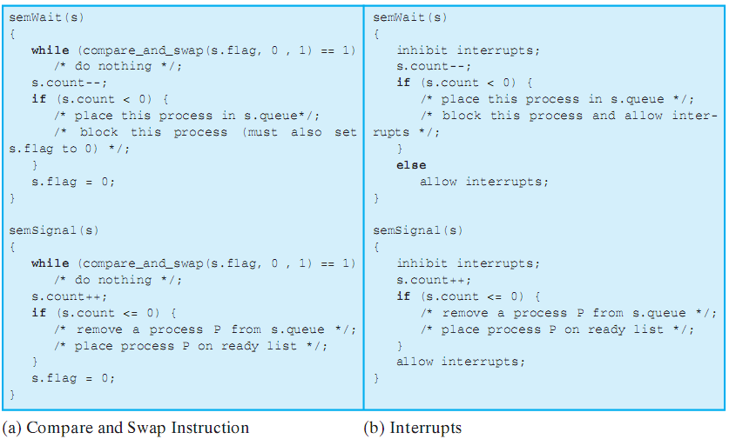
5.3.4 Implement of Semaphores

Slide 63
Agenda
5.1 Principles of Concurrency
5.2 Mutual Exclusion: Hardware Support
5.3 Semaphores
5.4 Monitors
5.5 Message Passing
5.6 Readers/Writers Problem
5.7 Summary

Slide 64
Monitors(管程)
Monitor is a software module consisting of one ore more procedures, an initialization sequence, and local data(管程由一个或者多个例程、一段初始化代码和局部数据组成). And the chief characteristics are the following:
  Local data variables are accessible only by the monitor
  Process enters monitor by invoking one of its procedures
  Only one process may be executing in the monitor at a time

Slide 65
Monitors Operations(管程操作)
A monitor supports synchronization by the use of condition variables (管程通过条件变量实现同步)
cwait(c): Suspend execution of the calling process on condition c. The monitor is now available for use by another process.
csignal(c): Resume execution of some process blocked after a cwait on the same condition. If there are several such processes, choose one of them; if there is no such process, do nothing.
Note that monitor wait and signal operations are different from those for the semaphore. If a process in a monitor signals and no task is waiting on the condition variable, the signal is lost.

Slide 66
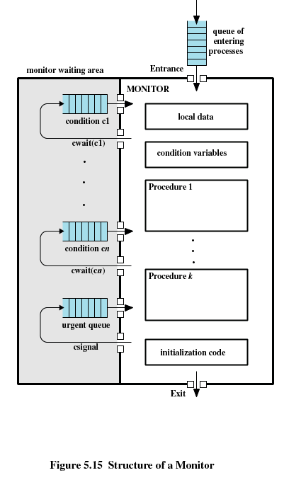

Slide 67
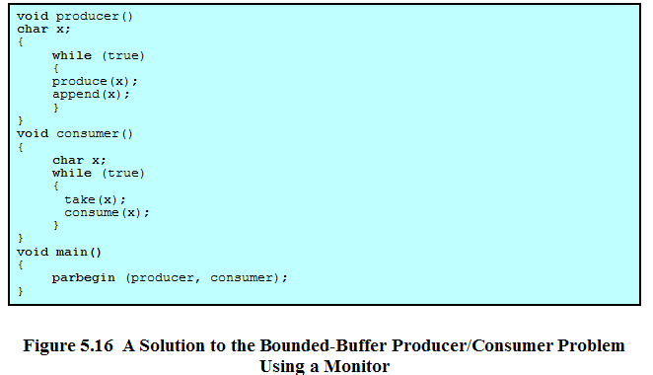
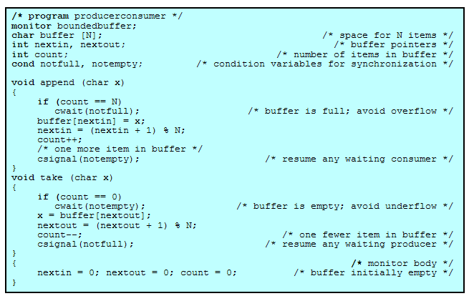

Slide 69
Agenda
5.1 Principles of Concurrency
5.2 Mutual Exclusion: Hardware Support
5.3 Semaphores
5.4 Monitors
5.5 Message Passing
5.6 Readers/Writers Problem
5.7 Summary

Slide 70
Message Passing
Enforce mutual exclusion
Exchange information
send (destination, message)
receive (source, message)

Slide 71
Synchronization
Sender and receiver may or may not be blocking
Blocking send, blocking receive
  Both sender and receiver are blocked until message is delivered

Slide 72
Synchronization
Nonblocking send, blocking receive
  Sender continues on
  Receiver is blocked until the requested message arrives
Nonblocking send, nonblocking receive
  Neither party is required to wait

Slide 73
Addressing
Direct addressing
  Send primitive includes a specific identifier of the destination process
  Receive primitive could know ahead of time which process a message is expected or receive primitive could use source parameter to return a value when the receive operation has been performed

Slide 74
Addressing
Indirect addressing
  Messages are sent to a shared data structure consisting of queues
  Queues are called mailboxes
  One process sends a message to the mailbox and the other process picks up the message from the mailbox

Slide 75
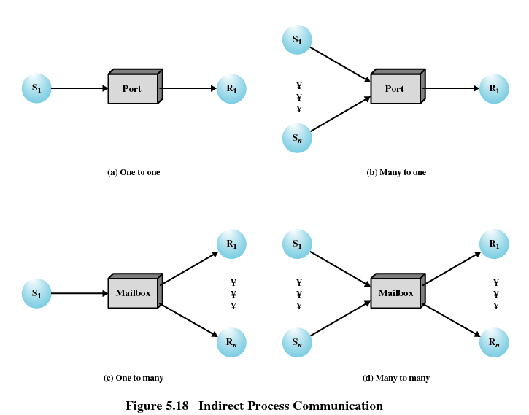

Slide 76
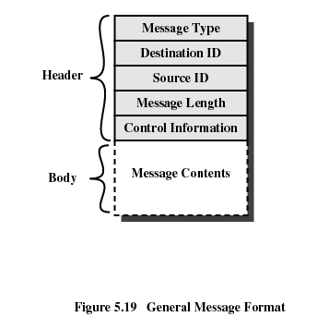
Message Format

Slide 77
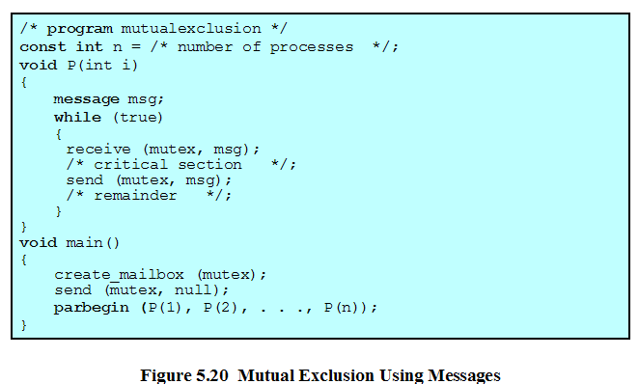

Slide 78
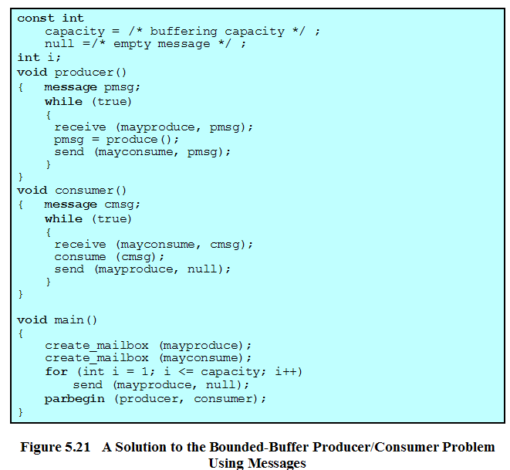

Slide 79
Agenda
5.1 Principles of Concurrency
5.2 Mutual Exclusion: Hardware Support
5.3 Semaphores
5.4 Monitors
5.5 Message Passing
5.6 Readers/Writers Problem
5.7 Summary

Slide 80
Readers/Writers Problem
Any number of readers may simultaneously read the file
Only one writer at a time may write to the file
If a writer is writing to the file, no reader may read it

Slide 81
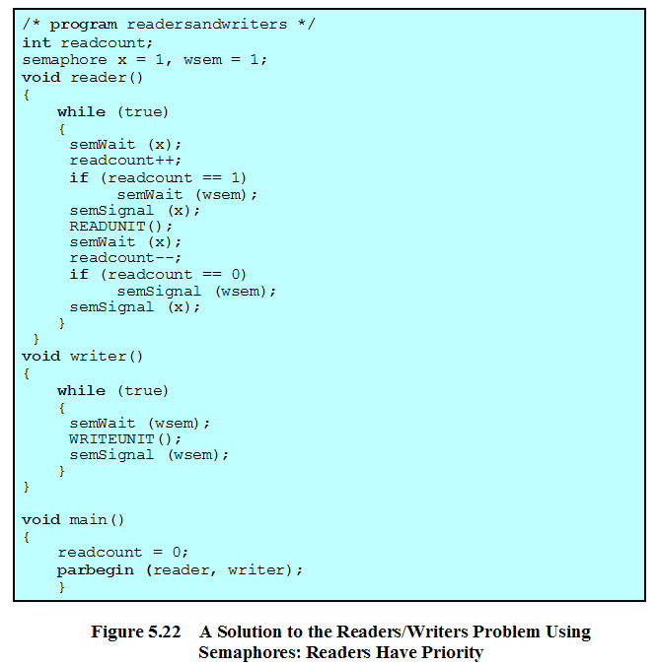
Readers/Writers Problem
正在读的进程数
用于读写/写写互斥保护
用于readcount修改保护

Slide 82
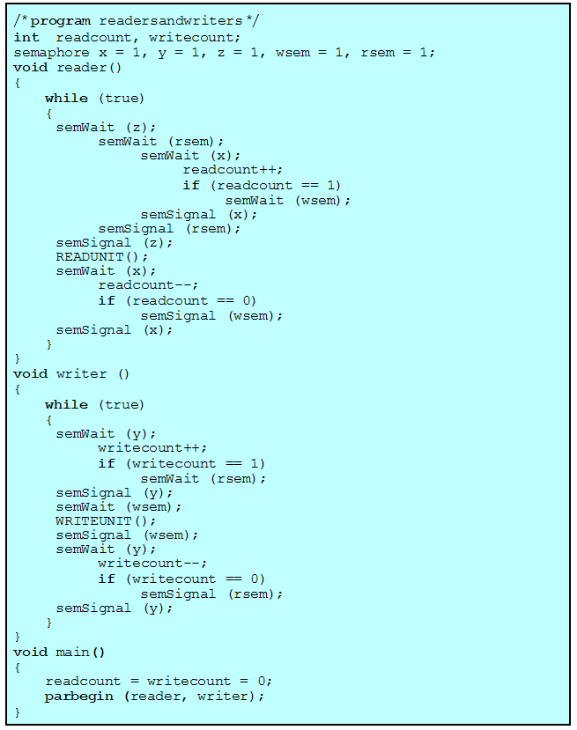

Readers/Writers Problem
readcount:正在读的进程数
rsem：当至少有一个写请求时，对新的读请求进行阻塞
wsem：用于读写互斥保护
writecount:正在和将要进行写的进程数
y：控制writecount的修改
x：控制readcount的修改
z: 只允许一个读进程在rsem上排队，其他读进程在z上排队

Slide 83
Agenda
5.1 Principles of Concurrency
5.2 Mutual Exclusion: Hardware Support
5.3 Semaphores
5.4 Monitors
5.5 Message Passing
5.6 Readers/Writers Problem
5.7 Summary

